Slide 1

Reading Skills
Semester 4 - Professional Grooming and Personality Development (303193252)

Slide 2
Learning Objectives
By the end of this session, students will be able to:
Understand the meaning and importance of reading comprehension.
Identify different types of reading techniques.
Recognize barriers to effective reading.
Apply strategies to comprehend a given passage.
Practice tips to improve reading fluency and retention.

Slide 3
Topics to be Covered
Meaning of Reading
Types of Reading
Barriers to Effective Reading
Essentials of Effective Reading
Tips for Effective Reading
Strategies for Comprehension
Activity

Slide 4
Introduction
Reading is the process of interpreting written symbols to derive meaning.
It is an active skill that requires attention and comprehension.
Example: Reading a newspaper headline and understanding its implication in context.

Slide 5
Types of Reading
Skimming – Quickly reading to get a general idea. Example: Browsing a news article for the main story.
Scanning – Searching for specific information. Example: Looking for a train time in a timetable.
Extensive Reading – For broad understanding of a subject. Example: Reading a novel or magazine article.
Intensive Reading – For detailed understanding. Example: Studying a paragraph in a textbook for a quiz.

Slide 6
Barriers to Effective Reading
Lack of concentration
Eye fixation problems
Regression (rereading due to confusion)
Overuse of dictionaries
Example: Losing focus during exam prep and rereading the same line repeatedly.

Slide 7
Essentials of Effective Reading
Phonemic awareness: understanding sound units in words Phonics: connecting sounds with letters Fluency: smooth, accurate reading Vocabulary: knowing word meanings in context Tip: Build vocabulary by reading a variety of genres.

Slide 8
Tips for Effective Reading
Develop a positive attitude toward reading. Underline or highlight key ideas. Use colored pens to code themes. Adjust reading speed based on material difficulty. Practice reading regularly to build stamina. Example: Use sticky notes while reading textbooks to summarize paragraphs.

Slide 9
Strategies to Understand a Passage
Identify the central idea
Read openings and endings of paragraphs carefully.
Pay attention to linking words.
Infer contextual meaning
Understand both literal and hidden meanings.
Use surrounding words to guess unfamiliar vocabulary. Example: In a passage, the word “grim” followed by "no one smiled" implies a serious mood.

Slide 10
Advanced Strategies
Discourse Analysis: Analyze tone, style, and use of literary devices like metaphor, imagery, etc. Example: Recognizing sarcasm in opinion pieces to detect author bias.

Slide 11
Activity
Reading Race – Skim, Scan & Summarize
Instructions:
Distribute a short article to each student.
1st read: Skim for the main idea (1 minute).
2nd read: Scan for specific info (dates, names) (1 minute).
Share key points with the class in 3 bullet points.

Slide 12
Activity
The self-presentation theory by Erving Goffman supposes that people develop their behaviour so as to manage impressions in social settings. People nowadays consume one another’s lives in the illusion of what they can present by the help of social media and because of that, young people are in a state of malaise and anxiety. The online performers glamorise their lives by choosing which of the segments of their lives to display and which of those to conceal. This image management is in line with Christopher Lasch’s idea of the “culture of narcissism” in which self-admiration suppresses virtues, allowing the space for acting,
but the sincerity of the connection is compromised.

Slide 13
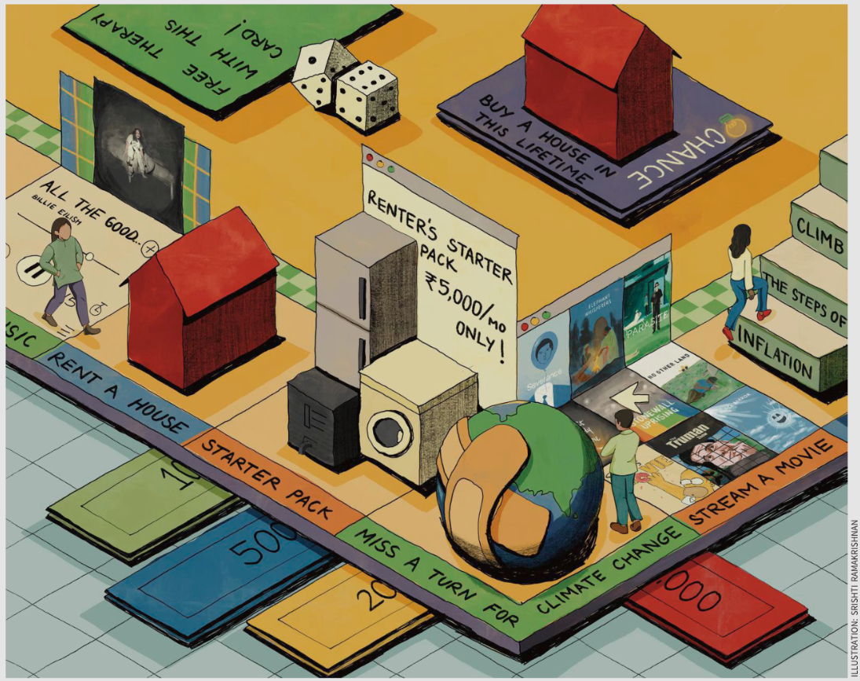
Fun - Activity
Read the given picture and write your observation in three sentences.

Slide 14
Conclusion
Reading comprehension improves academic and real-life communication.
Mastering various strategies helps decode meaning effectively and retain information.

Slide 15
Learning Outcomes
After this session, learners will be able to:
Define reading comprehension and its importance.
Use skimming, scanning, extensive, and intensive reading appropriately.
Overcome common reading barriers.
Apply strategies to grasp meaning from a passage.
Improve retention through purposeful reading.

Slide 16
Thank You

